Slide 1
Fake Social Media Profile Detection And Reporting
CSE7101- Capstone Project
Review-5
Batch Number:CCS_35
Under the Supervision of,
Dr. Sharmasth Vali Y
School of Computer Science and Engineering
Presidency University
Roll Number | Student Name
20221CCS0065 | Kritika Priya
20221CCS0104 | Deepika S
20221CCS0059 | Rishika H J
Name of the Program: CCS
Name of the HoD: Dr. Anandaraj S.P
Name of the Program Project Coordinator: Dr. Sharmasth Vali Y
Name of the School Project Coordinators: Dr. Sampath A K , Dr. Geetha A

Slide 2
Problem Statement Number: PSCS_587
Problem Description: Fake Social Media Profile Detection and Reporting is a software -based solution aimed at identifying and flagging fraudulent or malicious social media accounts. By analyzing user activity patterns, profile information, and anomalies, the system helps detect fake profiles and provides a reporting mechanism to enhance online safety, trust, and digital well-being.
Abstract:The rise of fake profiles on social media poses threats including misinformation, identity theft, and cybercrime. This work proposes a hybrid machine learning and deep learning approach combining profile, content, and network-based features for accurate detection. Leveraging NLP, computer vision, and ensemble models, the system ensures scalability, cost-effectiveness, and reliability, enhancing trust and security in online social ecosystems.

Slide 3
Objectives
Main Aim: To design and implement a Fake Social Media Profile Detection and Reporting System that leverages machine learning to identify and mitigate the risks associated with fake accounts.
Challenges faced in Social Media Platforms:
Proliferation of fake accounts spreading misinformation, scams, cyberbullying, and fraud.
Existing detection mechanisms focus mainly on bots, but human-created fake identities (trolls, impersonators) are harder to identify.
Graph-based systems like Google’s CopyCatch/Leas detect lockstep spam but require huge infrastructure, not feasible for small-scale deployment.
Reporting is often manual and delayed, reducing effectiveness in stopping cyber threats.

Slide 4
Analysis of Problem Statement (contd...)
Core Issues:
Difficulty in distinguishing between real vs fake profiles, especially human-driven deception.
Lack of real-time, automated reporting to platform authorities.
Limited access to large datasets for training robust ML models.
Privacy and ethical concerns in analyzing user data.
Impact:
Loss of trust in social media platforms.
Increased spread of disinformation & cybercrime.
Threats to individual safety (harassment, scams, identity theft).

Slide 5
Literature Survey
No. | Paper / Publication | Author(s) | Year | Description and Limitations
1. | In a World That Counts: Clustering and Detecting Fake Social Engagement at Scale | Yixuan Li, Oscar Martinez, Yi Li, John E. Hopcroft, Xing Chen | 2016 | Introduces LEAS (Local Expansion at Scale) for detecting fake engagement on YouTube using temporal graph analysis and MapReduce. Limitation: Focused on engagement metrics, not full fake identity detection.
2. | Using Machine Learning to Detect Fake Identities: Bots vs Humans | Estée Van Der Walt, J. Neloff | 2018 | Applies engineered features (e.g., friend-to-follower ratio) to detect both bots and human-created fake identities. Limitation: Human-created fake identities are harder to detect with high accuracy.
3. | Detecting Fake Accounts on Social Media | Sarah Khaled, Hoda Mokhtar, Neamat El-Tazi | 2018 | Proposes SVM-NN hybrid with feature selection/reduction for fake Twitter account detection. Outperforms standalone models. Limitation: Dataset-specific; lacks cross-platform generalization.

Slide 6
Literature Survey
i
4. | Unmasking Deception: Detection of Fake Profiles in Online Social Ecosystems | Amber Sarfraz, Adnan Ahmad, Frukh Zeshan, Muhammad Hamid, Tagrid Abdullah N. Alshalali | 2022 | Systematic Literature Review (SLR) of fake profile detection methods. Provides taxonomy of fake profiles (sybils, sock puppets, bots) and key challenges. Limitation: Theoretical framework; lacks real-world experimentation.
5. | Techniques to Detect Fake Profiles on Social Media Using New Age Algorithms – A Survey | A.K.M. Rubaiyat Reza Habib, Edidiong Elijah Akpan, Bhaskar Ghosh, Indira K. Dutta | 2022 | Reviews modern algorithms including ML, DL, and generative approaches for detecting fake profiles across Twitter, Instagram, and Facebook. Limitation: Pure survey; no comparative experiments.
6. | A Hybrid Machine Learning Model for Detection of Fake Profile Accounts on Social Media Networks | Morris Bosire Karamu, Eric Nyambariga Araka | 2022 | Presents a hybrid ML model to identify fake accounts created by bots and humans, emphasizing misinformation and security issues. Limitation: Conceptual; limited large-scale validation.
7. | A Review Article on Detection of Fake Profile on Social-Media | Shamim Ahmad, Manish Madhava Tripathi | 2023 | Reviews ML approaches to detect fake, spam, and duplicate accounts. Highlights need for robust detection frameworks. Limitation: Review-based; lacks implementation results.

Slide 7
Literature Survey
i
8 | Detecting Fake Social Media Profiles Using the Majority Voting Approach | Dharmaraj R. Patil, Tareek M. Pattewar, Vipul D. Punjabi, Shailendra M. Pardeshi | 2023 | Ensemble classifiers (Decision Tree, XGBoost, RF, KNN, etc.) combined with majority voting achieve 99.12% accuracy. Limitation: Accuracy may drop with noisy/unseen datasets.
9 | Deep Neural Network for Detecting Fake Profiles in Social Networks | Daniyal Amankeldin, Lyailya Kurmangaziyeva, Ayman Mailybayeva, Natalya Glazyrina, Ainur Zhumadillayeva, Nurzhamal Karasheva | 2023 | Proposes a DNN using 16 features; achieves 99.4% accuracy with minimal data. Limitation: Validated mainly on Facebook; cross-platform scalability unproven.
10 | Fake Social Media Profile Detection and Reporting Using Machine Learning | Aniket Agravat, Umang Makwana, Sahil Mehta, Devashish Mondal, Sushant Gawade | 2024 | Real-time detection using ML, NLP, and computer vision; flags and reports fake accounts automatically. Limitation: Resource-intensive; real-time deployment challenges.
11 | Detection of Fake Profiles on Online Social Network Platforms: Performance Evaluation of AI Techniques | Akash Shah, Sapna Varshney, Monica Mehrotra | 2024 | Compares ML vs DL (XGBoost, LSTM) on imbalanced datasets. LSTM best on large datasets, XGBoost best on smaller ones. Limitation: Needs live OSN validation.

Slide 8
Background And Related Work
Existing Applications / Tools:
Social Catfish
An online service that uses reverse image search and username lookup to detect catfishing and fake social media accounts.
Helps individuals verify if a profile is real by checking across multiple platforms.
Cyabra
An AI-driven enterprise platform that detects fake accounts, bots, and disinformation campaigns in real time.
Used by governments and organizations to monitor coordinated fake engagement at scale.
Bytescare – Fake Profile Remover
A brand-protection tool that automatically identifies and reports impersonation profiles across platforms like Facebook, Instagram, and Twitter.
Focused on businesses to prevent reputation damage.

Slide 9
Drawbacks in Existing Applications
Social Catfish (Reverse Image & Username Lookup Service)
Primarily designed for catfishing / romance scam detection, not full-fledged fake profile detection.
Limited to cross-checking existing public information, not predictive ML-based detection.
Cyabra (Enterprise AI Platform)
Highly effective for large-scale disinformation campaigns, but built for governments and enterprises.
Bytescare – Fake Profile Remover
Brand-oriented solution, mainly for companies protecting reputation, not general users.
Works reactively (after fake profiles appear) rather than proactively predicting suspicious accounts.

Slide 10
Proposed Method
This project proposes a hybrid approach that integrates machine learning models with blockchain technology to improve the detection and verification of fake social media profiles.
Key Components of the Proposed System:
• Machine Learning-Based Fake Profile Detection
– Three machine learning models (Random Forest, SVM, XGBoost, and ANN) are used to classify profiles as real or fake based on extracted features.
– Features such as follower count, following count, bio length, profile photo presence, and privacy status are used for classification.
– A dataset with labeled fake and real profiles is used to train the models.
• Blockchain Integration for Security and Transparency
– Ethereum blockchain is used to store flagged fake profiles in an immutable ledger.
– Smart contracts automate the verification and reporting of fraudulent accounts.
– InterPlanetary File System (IPFS) is used for decentralized storage of reported profiles.
• User Interface for Profile Verification
– A Django-based web application allows users to input profile data and receive real-time predictions.
– A fraudulent profile reporting system enables users to report suspicious accounts, with all reports being securely stored on the blockchain.

Slide 11
Dataset for the Project
For our Fake Social Media Profile detection application, we assembled a dataset comprising real and fake social media profiles. The dataset includes features such as:
• Profile Metadata: Account age, number of friends/followers, frequency of posts, profile picture existence, bio information, and language usage.
• Behavioral Patterns: Posting frequency, engagement metrics (likes, comments, shares), and activity time-series data.
• Textual Data: Natural language content from posts, comments, and profile descriptions.
• Network Features: Connection patterns, friend network clustering, and interaction graphs.
Data Sources:
• Publicly Available Datasets: We leveraged open-source datasets (e.g., from research projects on social bot detection) that include labeled examples of genuine and fake profiles.
• Synthetic Data: In cases where data was imbalanced or under-represented, we applied data augmentation techniques to simulate fake profiles based on known behavioral patterns.

Slide 12
Machine learning algorithms:
RANDOM FOREST(RF):
What is Random Forest?
• An ensemble learning method that builds a collection of decision trees.
• Each tree votes, and the majority class becomes the final prediction.
• Works by combining multiple models to reduce variance and increase accuracy.
SUPPORT VECTOR MACHINE(SVM):
What is SVM?
• A supervised learning algorithm used for classification tasks.
• Finds the optimal hyperplane that best separates two classes (real vs fake profiles).
• Maximizes the margin between the nearest data points (support vectors).

Slide 13
ANN(Artificial Neural Network)
What is an ANN?
• An Artificial Neural Network is a computing model inspired by the structure of the human brain.
• Consists of layers of neurons (nodes) interconnected through weights.
• Capable of learning complex, nonlinear relationships in data.
XGBoost
What is XGBoost?
• Extreme Gradient Boosting – a powerful boosting algorithm.
• Combines weak learners (usually decision trees) in a sequential manner.
• Each new model focuses on correcting the errors made by previous ones.
• Uses advanced regularization techniques (L1 & L2) to avoid overfitting.

Slide 14
Random Forest (RF):
– Why:RF is an ensemble learning method that builds multiple decision trees and merges their outputs. It is robust to overfitting, works well with both numerical and categorical data, and can effectively capture complex, non-linear interactions between features.
– Comparison:
• Versus Logistic Regression: While logistic regression is faster and easier to interpret, it may struggle with non linear relationships that RF can capture.
• Versus Naïve Bayes: Naïve Bayes is computationally efficient and works well with text data; however, its strong independence assumptions often do not hold in social network data.
Support Vector Machines (SVM):
– Why:SVM is effective in high-dimensional spaces and can handle non-linear boundaries through kernel functions. It works particularly well with text-based features after vectorization.
– Comparison:
• Versus Decision Trees: While decision trees are easy to interpret, SVM generally provides a more stable decision boundary when the feature space is complex

Slide 15
ANN(Artificial neural network)
Why: ANN is inspired by the human brain’s neural structure. It uses layers of interconnected neurons to model and learn complex, nonlinear patterns. In the context of fake profile detection, ANN is especially valuable for capturing hidden patterns in user behavior and engagement metrics.
Comparison:
• Versus Naïve Bayes: Naïve Bayes assumes feature independence and often falls short on complex data; ANN thrives on discovering dependencies and nonlinear relationships.
Extreme Gradient Boosting (XGBoost):
Why: XGBoost is a powerful and efficient implementation of gradient-boosted decision trees. It builds models sequentially, where each model corrects the errors of its predecessor. It includes regularization to reduce overfitting and supports parallel computation, making it ideal for high-accuracy, real-world applications.
Comparison:
• Versus Logistic Regression: Logistic regression is simple and interpretable but struggles with feature interactions and nonlinearity, which XGBoost handles natively and efficiently

Slide 16
Technologies Used:
Frontend Technologies:
HTML & CSS:Structure and design of the web interface.
JavaScript: Enhances interactivity and handles dynamic updates.
Backend Technologies:
Django (Python Web Framework): Handles user interactions, machine learning model integration, and blockchain transactions.
Python: Used for backend logic, machine learning model execution, and blockchain communication.
Machine Learning Technologies:
Scikit-learn: Implements classification algorithms such as Random Forest, Support Vector Machine (SVM), and Artificial Neural Networks (ANN) for detecting fake profiles.
pandas & numpy: Process and structure user data for model prediction.
pickle: Saves and loads trained models for efficient execution.

Slide 17
Machine Learning Models:
Random Forest (RF): An ensemble learning method based on decision trees that effectively handles large datasets and captures non-linear relationships.
Support Vector Machine (SVM): A supervised classification algorithm that identifies fake profiles based on feature analysis.
Artificial Neural Network (ANN): A deep learning model that captures complex patterns in user profiles, improving detection accuracy over time.

Slide 18
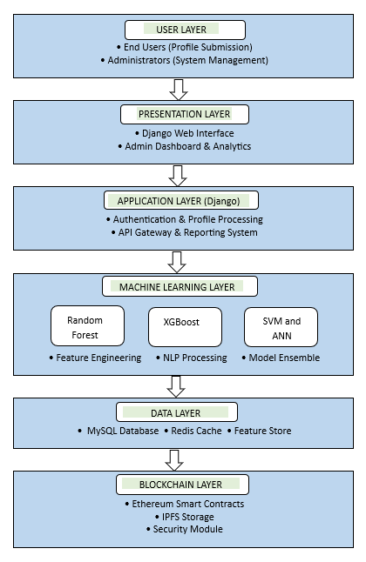
Architecture Diagram

Slide 19

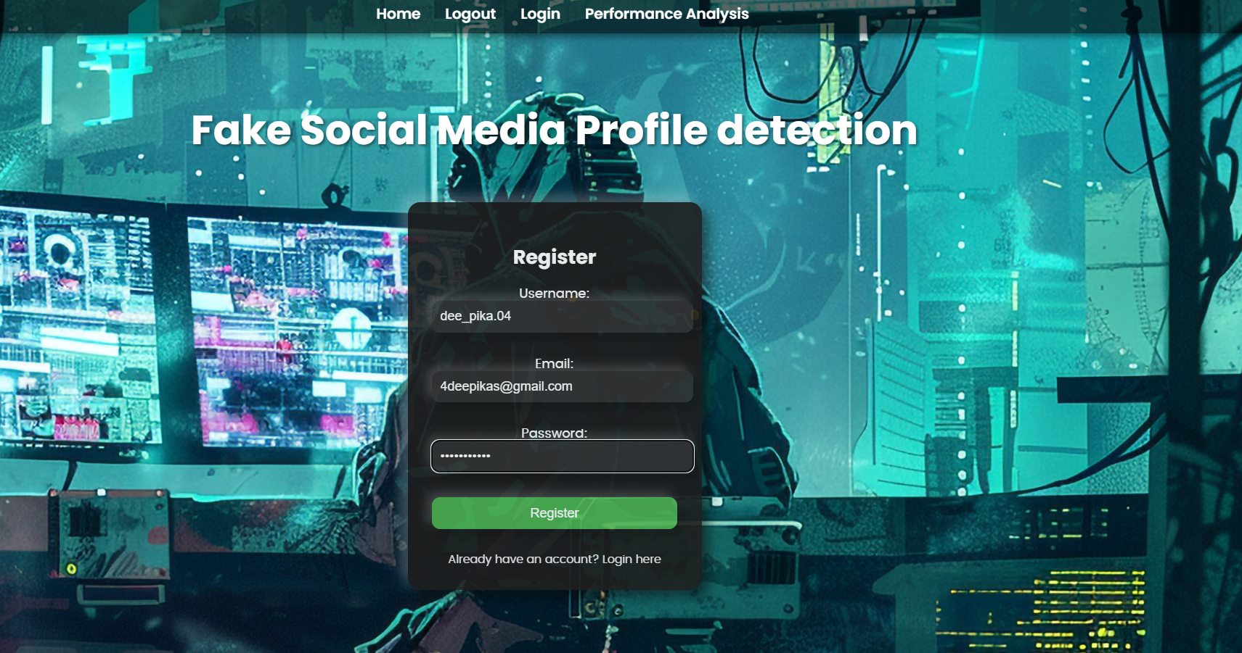
Screenshots of the project

Slide 20
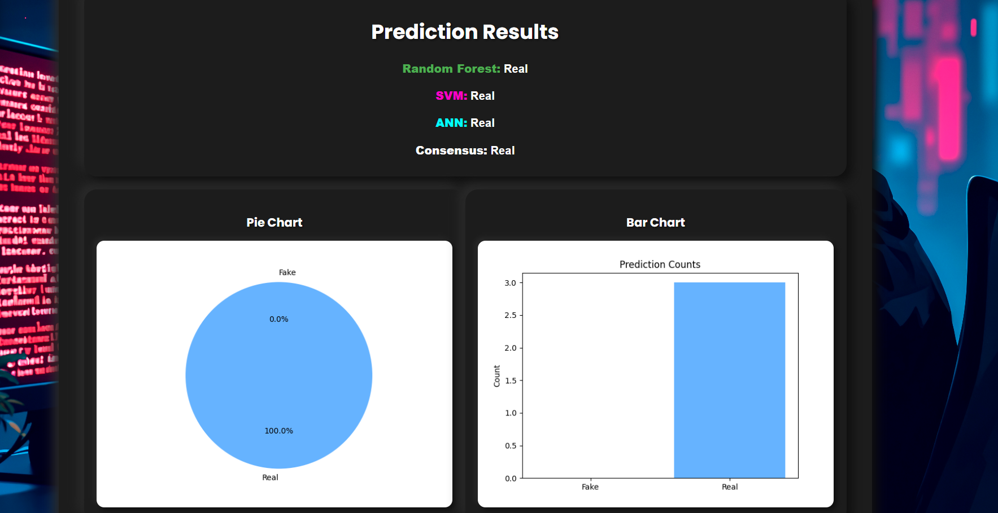

Slide 21

Project work mapping with SDG

Slide 22
Timeline of the Project (Gantt Chart)
Phase | W1 | W2 | W3 | W4 | W5 | W6 | W7 | W8 | W9 | W10 | W11 | W12
Requirement Analysis & Literature Review
Dataset Collection & Preprocessing
Model Development & Training
System Integration & Reporting
Testing, Evaluation & Documentation

Slide 23
Github Link
https://github.com/Kritika3094/Fake-Social-Media-Profile-Detection-And-Reporting

Slide 24
References
[1] Y. Li, O. Martinez, Y. Li, J. E. Hopcroft, and X. Chen, (2016). In a World That Counts: Clustering and Detecting Fake Social Engagement at Scale. In IEEE International Conference on Data Mining (ICDM) workshop on Data Mining on the Web (WDM) (pp. 110-119). [Publisher location: IEEE].
[2] E. Van Der Walt, & J. Nel-off. (2018). Using Machine Learning to Detect Fake Identities: Bots vs. Humans. In IEEE International Conference on Advances in Computing and Communication Engineering (ICACCE) (pp. 1-6). [Publisher location: IEEE].
[3] S. Khaled, H. Mokhtar, and N. El-Tazi. (2018). Detecting Fake Accounts on Social Media. In IEEE International Conference on Computer Engineering and Systems (ICCES) (pp. 176-183). [Publisher location: IEEE].
[4] A. Sarfraz, A. Ahmad, F. Zeshan, M. Hamid, and T. A. N. Alshalali. (2022). Unmasking Deception: Detection of Fake Profiles in Online Social Ecosystems. IEEE Access 10, (pp. 10,345 -10,359). [Publisher location: IEEE].
[5] A. K. M. R. R. Habib, E. E. Akpan, B. Ghosh, and I. K. Dutta. (2022). Techniques to Detect Fake Profiles on Social Media Using New Age Algorithms – A Survey. IEEE Access 10, (pp. 205,678 - 205,695). [Publisher location: IEEE].
[6] The work of M.B. Karamu and E.N. Araka titled "A Hybrid Machine Learning Model for Detection of Fake Profile Accounts on Social Media Networks" was published in 2022 in IEEE Access, vol. 10, pp. 109822-109834.
[7] S. Ahmad and M. M. Tripathi's work "A Review Article on Detection of Fake Profile on Social-Media" was published in 2023 at IEEE International Conference on Computing, Power and Communication Technologies (GUCON), pp. 1-6.
[8] D. R. Patil et al. work titled "Detecting Fake Social Media Profiles Using the Majority Voting Approach" was in 2023 in IEEE Access, vol. 11, pp. 153220-153231.
[9] D. Amankeldin et al. article "Deep Neural Network for Detecting Fake Profiles in Social Networks" was authored in 2023 in IEEE Access, vol. 11, pp. 122320-122335.
[10] A. Agravat et al.'s article "Fake Social Media Profile Detection and Reporting Using Machine Learning" was published in 2024 at IEEE International Conference on Communication and Electronics Systems (ICCES), pp. 1-6.

Slide 25


